Slide 1
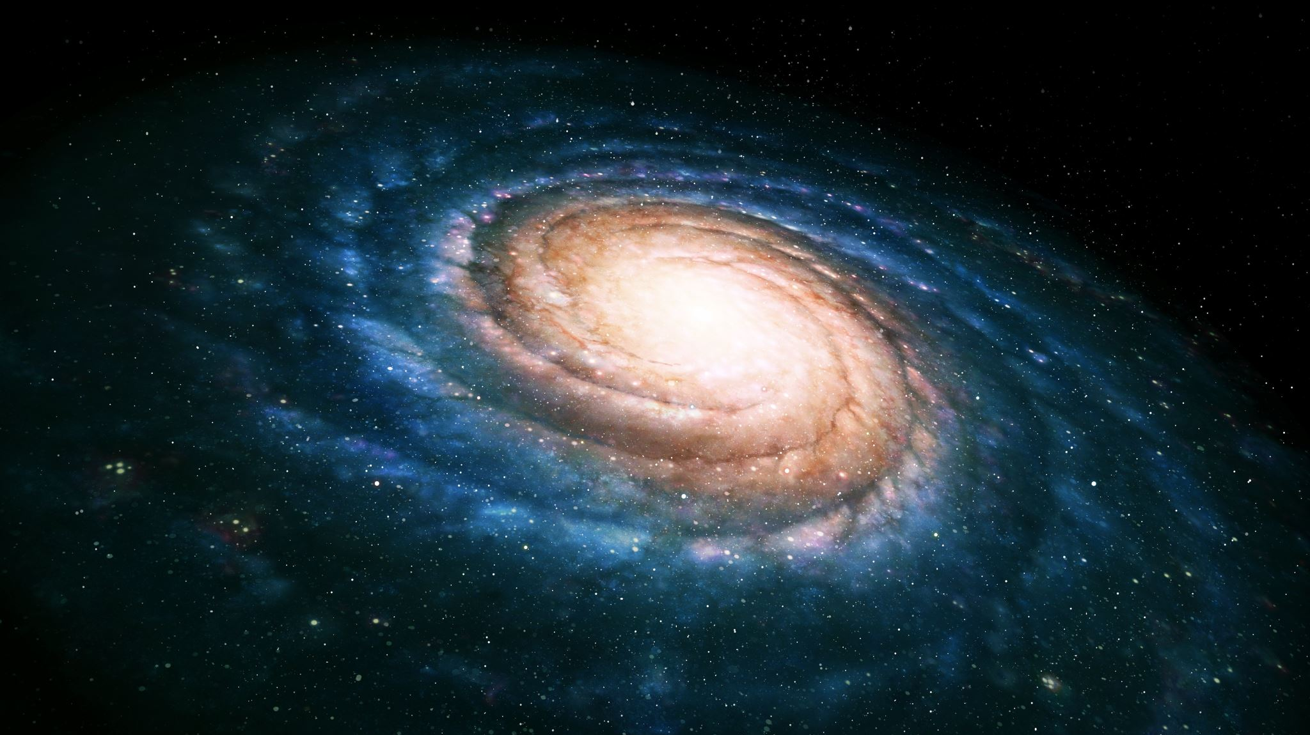
Process

Slide 2
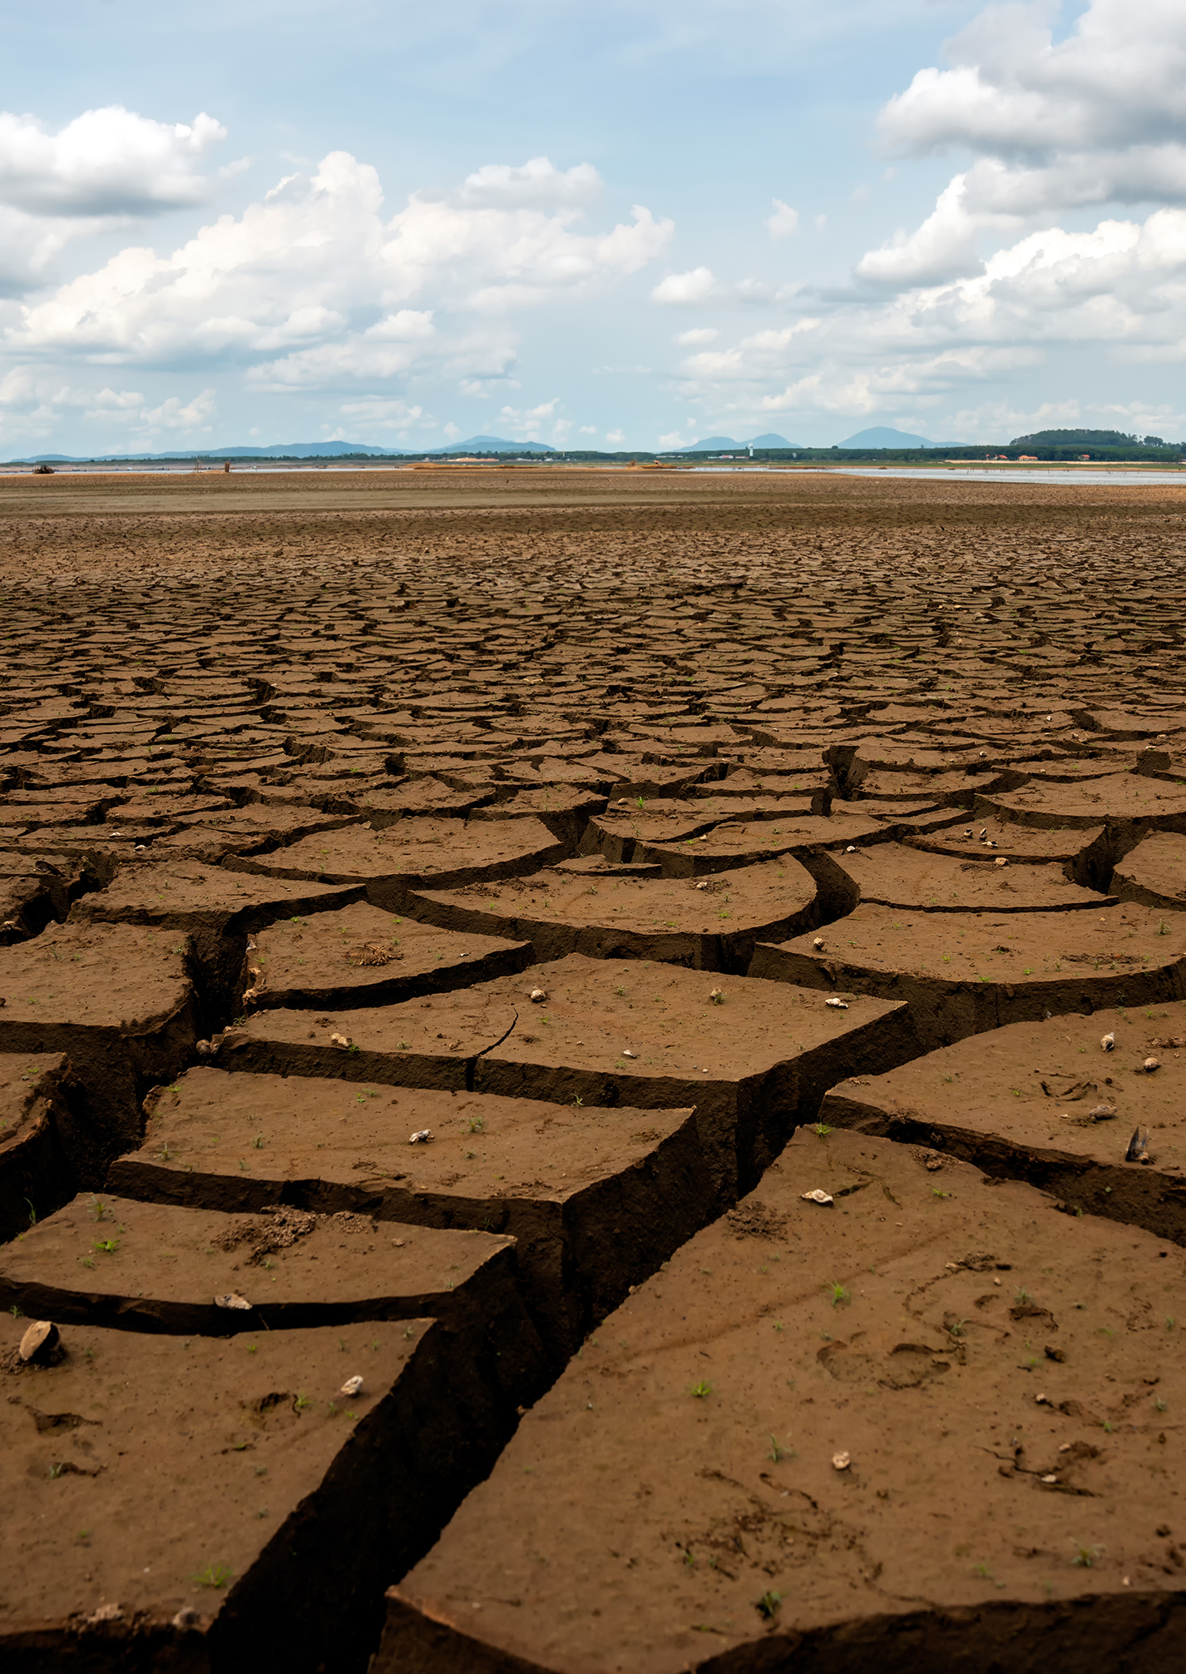
Motivation
According to the United Nations, Earth’s population is projected to keep rising for the next 60 years, reaching a peak of about 10.3 billion in the mid-2080s. With this continuous growth, Earth will face increasing challenges related to resources, sustainability, and population management. As demands for food, water, and energy increase, and as climate change and environmental degradation threaten the sustainability of ecosystems, the question arises: how can humanity ensure its long-term survival? This question becomes more urgent in light of reality: humans are consuming earth’s resources at an alarmingly high rate. Forests are being cleared faster than they can be regrown, freshwater supplies are dwindling in many regions across the globe, and non-renewable energy sources such as fossil fuels—which currently make up 82% of global energy consumption—are being rapidly depleted. Even renewable resources, such as wind, solar, and geothermal energy, are being pushed to their limits by growing demand and economic constraints. With a growing population consuming more than the planet can sustainably provide, Earth, on its own, may not be enough to support humanity’s needs. This leads us to the problem: How can we sustain humanity? Through the use of the Exoplanet archive, we will explore what factors can get us closer to this new home and what are potential candidates for a home.

Slide 3
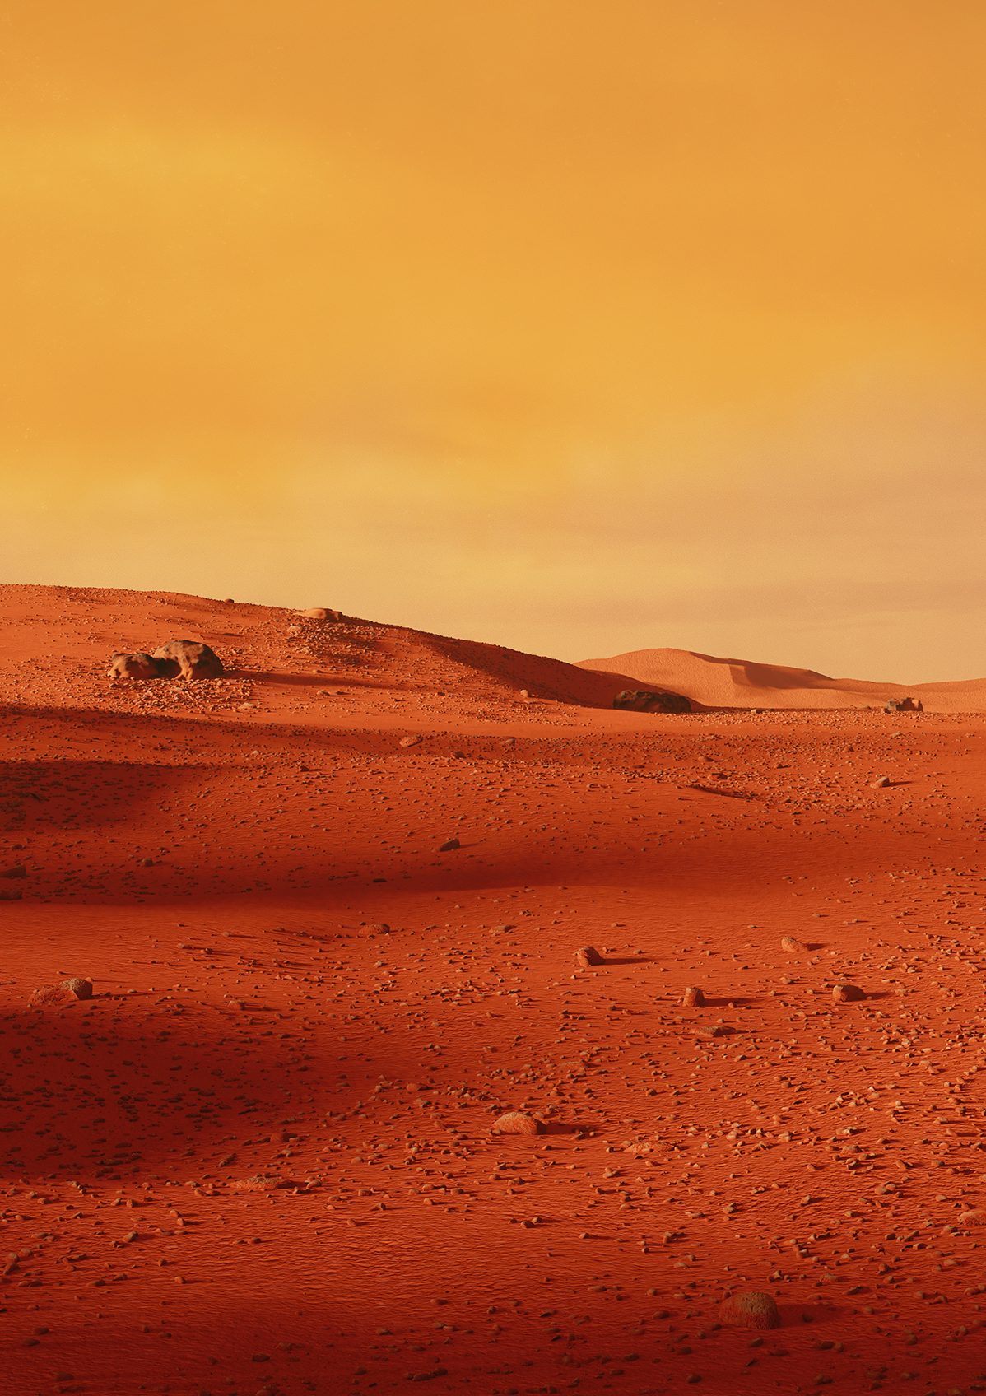
Methodology
We began by exploring the database to identify key variables relevant to planetary habitability and examined their relationships. Columns with a high proportion of missing values were removed to ensure data quality.
With the remaining data, we performed an inner join to create a unified table free of null entries. Using pandas, we engineered new quantitative features, such as planetary density, and introduced categorical classification fields based on scientifically informed thresholds to better capture indicators of habitability.
To visualize and refine our feature selection, we generated interactive histograms of density and applied color-coded “hues” based on researched benchmarks to distinguish terrestrial from gaseous planets. We then identified the most informative variables and computed summary statistics to analyze central tendencies and variability.
To consolidate different variables, we standardized the units and created a standard unit distance based on these variables from Earth’s standard units.
Histograms were used to further examine the distributions of these variables, allowing us to filter out planets that fell outside the desired ranges. Finally, we integrated the curated dataset, representing planets within a reasonable distance and meeting our habitability criteria into an API for display on the website.

Slide 4
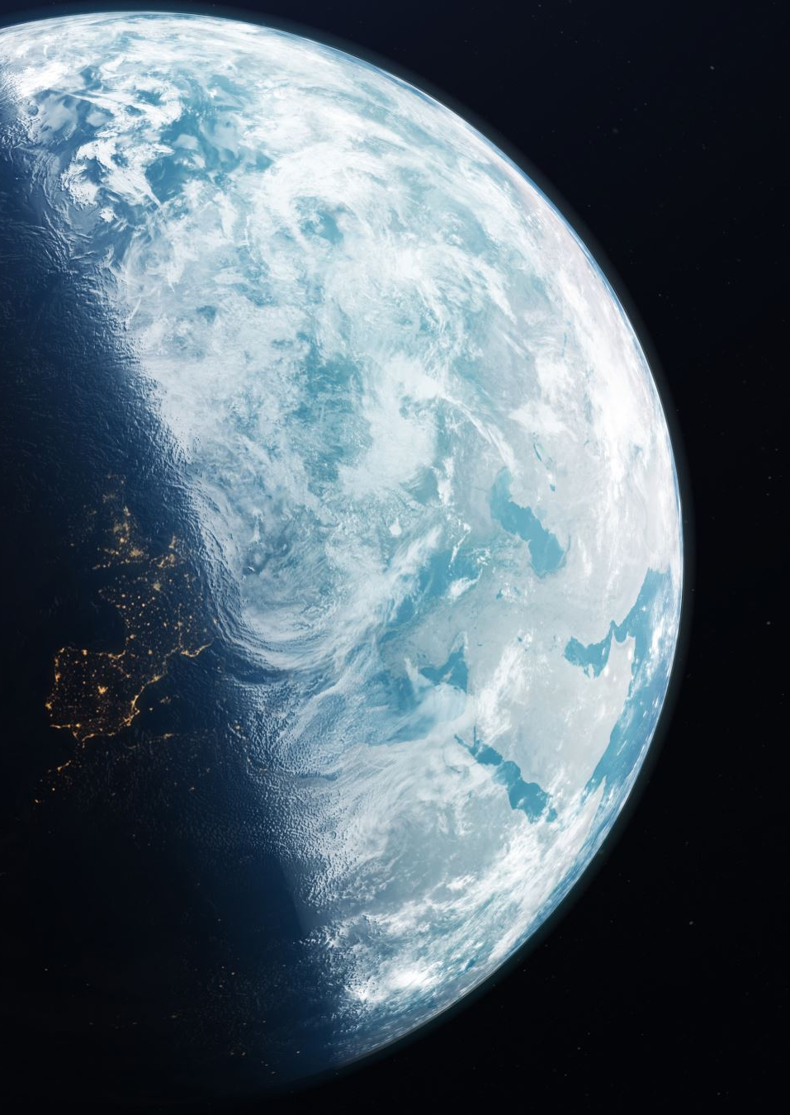
6 Variables
Planetary Radius (pl_rade): The radius of the planet as a ratio to Earth’s radius. Dictates gravity, atmospheric pressure, and the state of water on a planet.
Planetary Mass(pl_masse): The mass of the planet as a ratio to Earth’s mass. Determines the ability to maintain a magnetic field, terrestrial state, and maintaining an atmosphere.
Stellar Insolation(pl_insol): The amount of light the planet receives compared to Earth per a square unit on average. This indicated the climate on the planet.
Equilibrium Temperature(pl_eqt): Estimate of average temperature based on star distance and insolation. Can help to determine surface temperature and cooling or reflection.
Stellar Effective Temperature(st_teff): The surface temperature, flares, and wavelength. Can help determine the radiation stability.
Orbital Eccentricity(pl_orbeccen): The sensitivity of the seasons and climate through the orbit. Lower values can give a more stable bodies of water and climate, preventing huge swings or collapses.

Slide 5
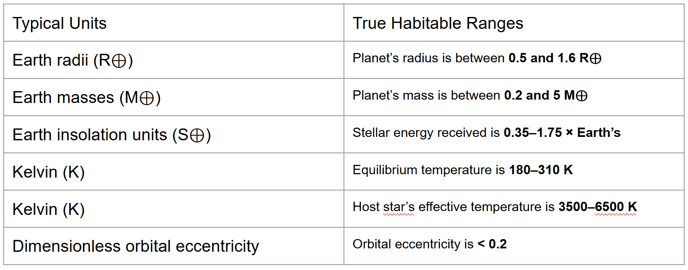

Slide 6
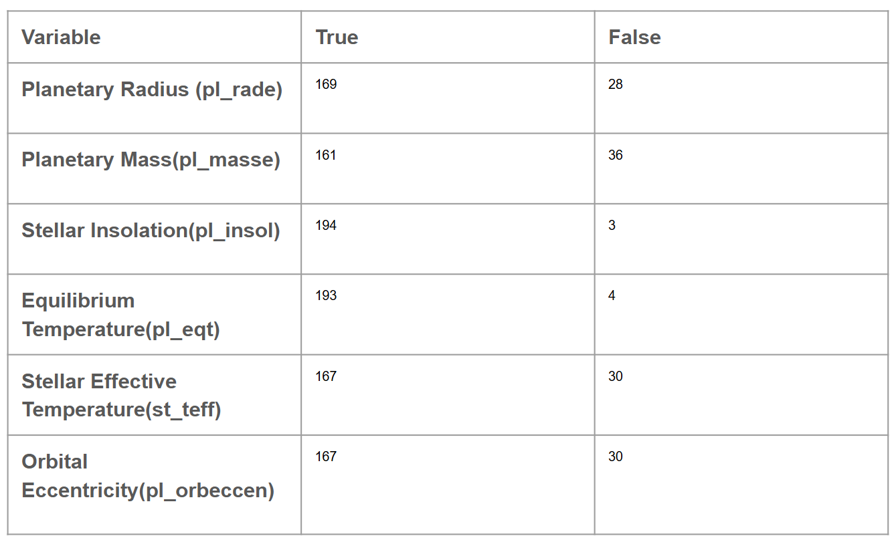
Deciphering Between Habitability

Slide 7
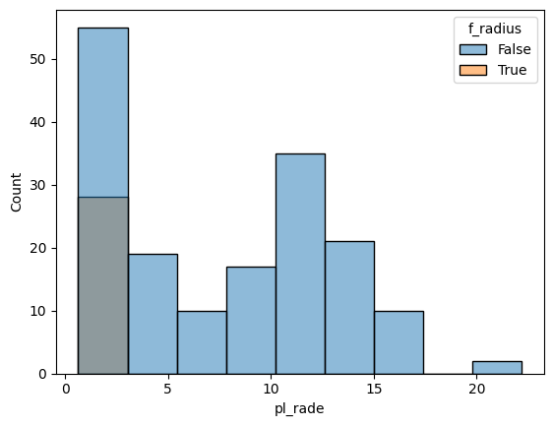
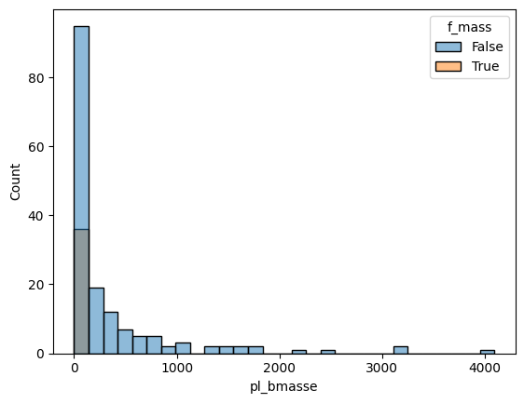
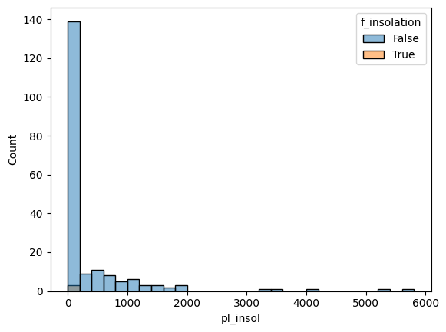
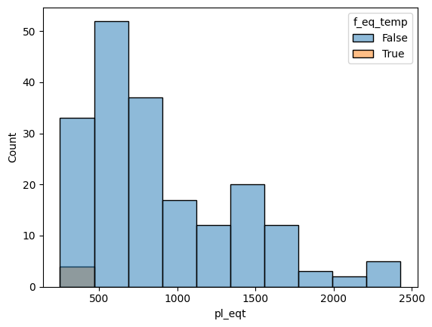
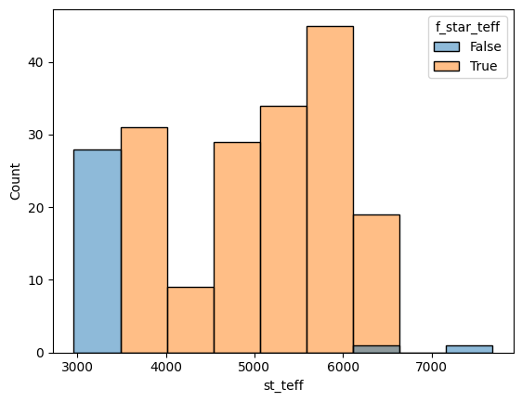
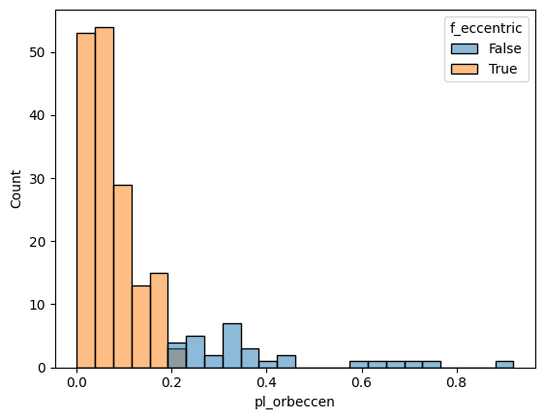

Slide 8
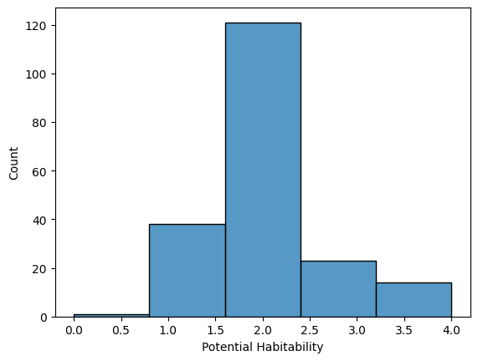
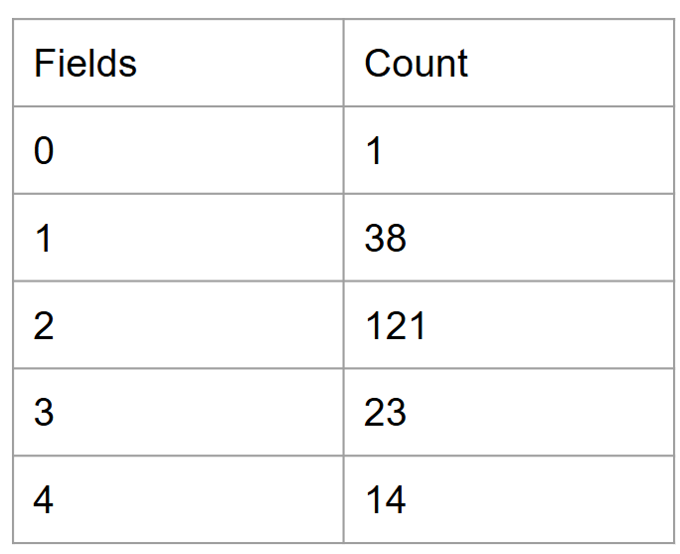
Fields Attained
How many planets passed The Conditions?

Slide 9

Introducing Second Earth

Slide 10
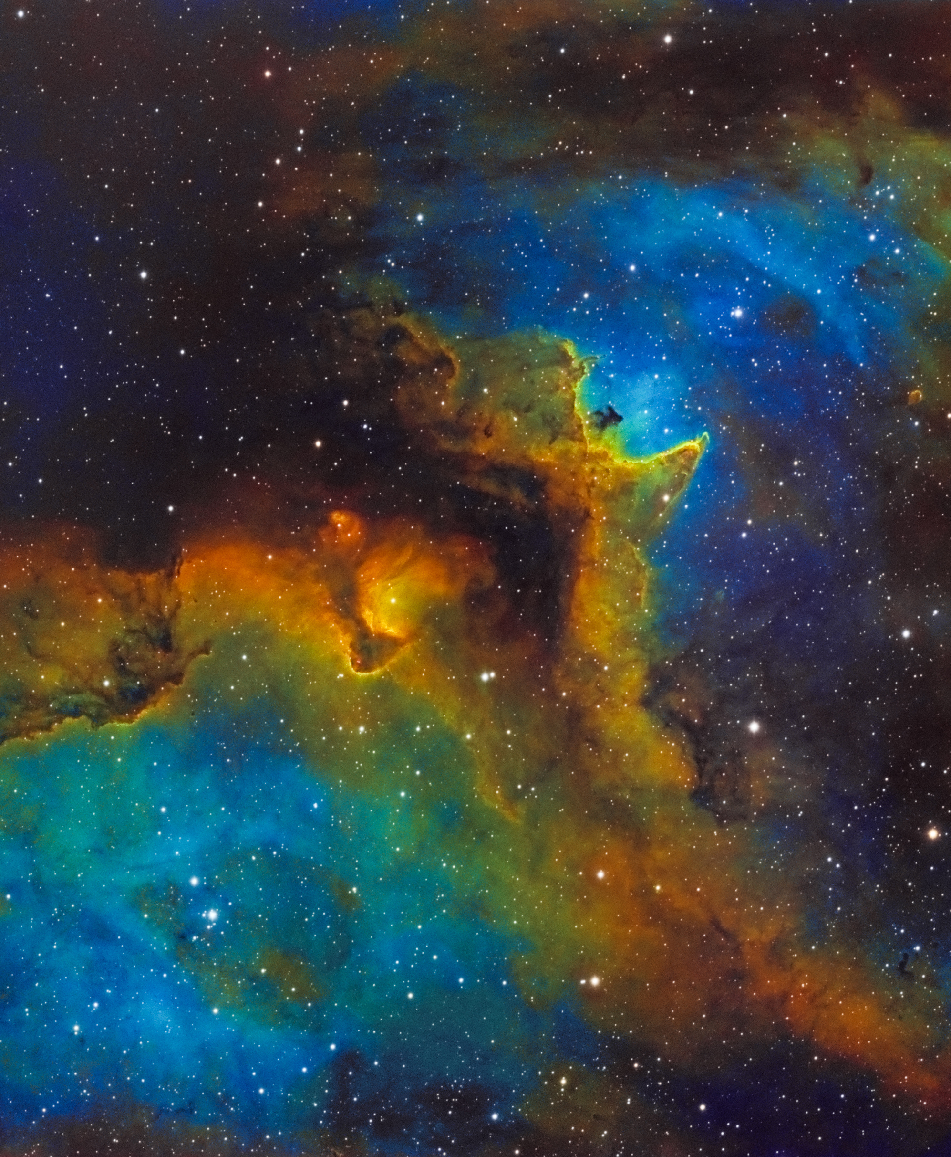
Results
Through our desired variables we were able to create a set of planets that are more habitable than majority of the planets found in archive, saving researchers time from sorting through the thousands of planets. Furthermore, we have the basis to create a classification model, the habitable score decision tree or regression model for a habitation score. Overall, we built a way to conveniently and clearly display direction for discovery, accelerating the process sustaining human life.

